Slide 1
Apama Training
Introduction and
Architecture
Dr Matthew Johnson
Apama R&D

Slide 2
Outline
1.
Apama Introduction
2.
Worked Exercises
3.
Apama in the Cloud
4.
Apama Integration

Slide 3
Apama Introduction

Slide 4
What is Apama

Slide 5
What is Apama for

Slide 6
What is Apama Not for

Slide 7
Key Apama Concepts

Slide 8
What is EPL

Slide 9

Worked Exercises

Slide 10
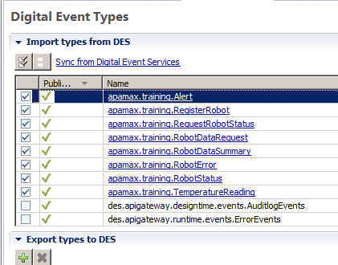
Importing and Connecting to DES
Open Project from Filesystem
The project has been pre-configured with the connection to UM via the DigitalEventServices.properties
You need to get a copy of the Type Repository for the DES types you want to access. For this project it’s provided with the project and must be copied to SoftwareAG/common/ DigitalEventServices/TypeRepository/
You need to import the specific types you want to use. You can get this dialogue by opening EventTypeList.apamades. Save the page once you’ve added the types

Slide 11
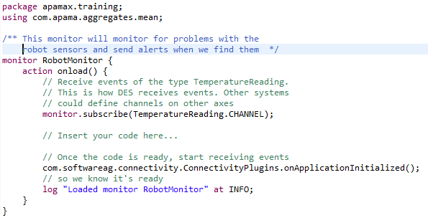
Basic Apama Application
In RobotMonitor.mon is a basic Apama monitor to work from.
The basic component of an Apama program is a monitor. It has an onload action which is run at startup.
This subscribes to a DES channel, signals that it’s ready to receive events and then logs to tell us so
There’s a space for us to insert code to actually do something

Slide 12
Exercises #1
Send a one-off test Alert from your application (substitute your name):
send Alert(“Matt”, “Test alert”) to Alert.CHANNEL;
Now Run your code as an Apama Application. The console should show the Apama log output and your alert should show on my dashboard.
Stop it when you’re done so we can make more changes
Receive sensor events and alert the temperature: on all TemperatureReading(id=1, sensor=1) as tr { send Alert(“Matt”, “Temperature for sensor 1 is ” +tr.temperature.toString()) to Alert.CHANNEL; }

Slide 13
Exercises #2
Alert for any sensor above a threshold: on all TemperatureReading(temperature > 40.0) as tr { send Alert(“Matt”, “Temperature for robot ” + tr.id.toString() + “ is ” + tr.temperature.toString()) to Alert.CHANNEL; }
Receive sensor events and alert the temperature: on all TemperatureReading(id=5, sensor=1, temperature > 40.0) as tr1 -> TemperatureReading(id=5, sensor=2, temperature > 40.0) as tr2 within(10.0) { send Alert(“Matt”, “Temperature for both sensors above threshold”) to Alert.CHANNEL; }

Slide 14
Exercises #3
Aggregate temperature and warn on aggregate threshold: from tr in all TemperatureReading() within 10.0 group by tr.id, tr.sensor having mean(tr.temperature) > 40.0 select TemperatureReading(tr.id, tr.sensor, mean(tr.temperature)) as mr { send Alert(“Matt”, “Average temperature for ” + mr.id.toString()+ “ is ” + mr.temperature.toString()) to Alert.CHANNEL; }

Slide 15
Exercises #4
(Now it’s your turn)
Temp varies more than +/- 1 degree
Two temperature sensors on one robot more than 5 degrees difference
Show count of how many robots exist
Robot exists but isn’t sending data
Robot is reporting explicit errors
Temperature spikes outside historic range
Temperature updates less than every 2s
Show min/max/mean values for each sensor
Get list of all robots with their state
A temperature sensor is stuck
A robot only sends values for one sensor
Temperature sensor is on average increasing over time
Robot with temperature outside the range of the other robots
Anything else interesting you might be able to calculate or monitor for – I want to see your ideas!

Slide 16
Apama in the Cloud

Slide 17
Running an apama application in the cloud
Right click on the project and select Apama -> Add Docker Support
Open a command window and browse to the project
Setup connection to the Docker server: set DOCKER_HOST=hydra.apama.com:2375
Build the project as an image: docker build -t %USERNAME%/client project
Run it in the cloud: docker run --rm --name %USERNAME% -d %USERNAME%/client
Check the logs, then stop and delete it: docker logs -f %USERNAME% docker stop %USERNAME%

Slide 18
Apama Integration

Slide 19
Integration points

Slide 20
External products

Slide 21
SAG Products via DES

Slide 22
Universal Messaging

Slide 23
Terracotta

Slide 24
Mashzone

Slide 25
Cumulocity

Slide 26
Analytics Builder

